Slide 1
‘Wisdom system’ band design project information
Project Produced by Benjamin Mullins
Website: http://benmullins.coventry.domains
Twitter: @benmullinsmedia

Slide 2
Stage 1: Pre-Production process
The band’s genre will be alternate metal with an anti-establishment and pro-democracy messages.
The process began with rough sketches and drawings based on a conversation with the band.
Early suggestions from feedback related to the sketches indicated that the band favoured a grunge-esque look to the font and related imagery.

Slide 3
Stage 2: Fonts
FONT 1: Chinese Rocks Font
Font available online from: https://www.1001fonts.com/chinese-rocks-free-font.html
License: Free for commercial use
Example of Font 1:
Wisdom System
FONT 2: Eordeoghlakat Font
Font available online from: https://www.1001fonts.com/eordeoghlakat-font.html
License: Free for commercial use
Example of Font 2:
Wisdom System

Slide 4
Stage 3: Colours
These colours were decided upon by the band’s suggestions as well as thoughts on which colours may suit the views/ genre/ themes of the band.
Initially, colour 2 was chosen as an alternative to colour 1.
One logo design was also specifically designed to suit each of colour 1 and colour 2, with colours 3 and 4 being used as staples throughout all designs.

Slide 5
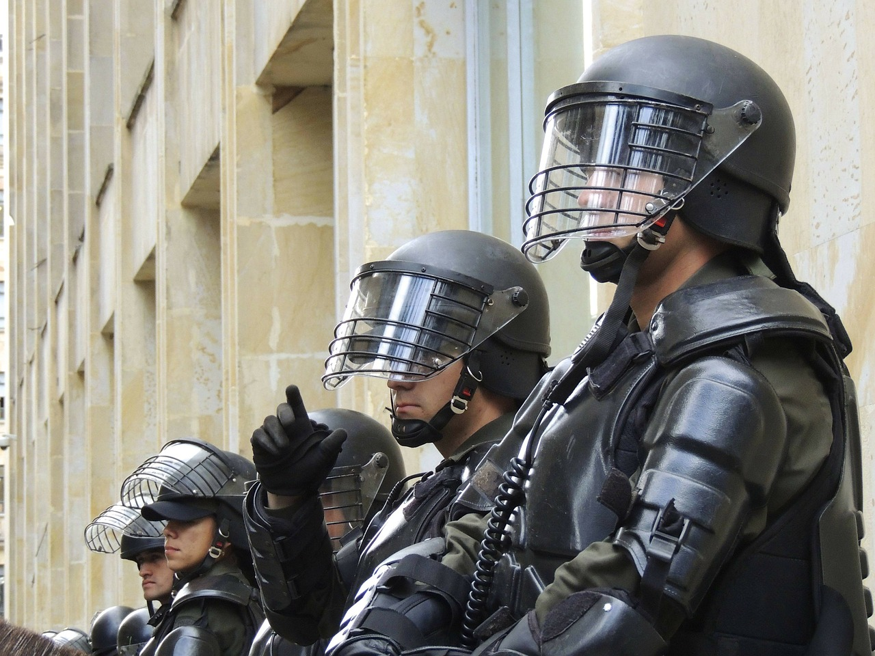
Stage 4: Licensing
All items used (fonts, stock images, etc.) have been checked to ensure that the licensing specifies that commercial use is accepted.
For 2 of the designs, a stock image (Figure 1) was used from pixabay.com. This was used in a transformative capacity which, alongside commercial use, is accepted under the Pixabay license. No attribution is required. https://pixabay.com/service/license/
All fonts were checked for licensing and were available for free commercial use. See fonts slide for more details.
Figure 1: A stock image of Riot Police from pixabay.com, free for commercial use.

Slide 6
Stage 5: Production
Each design was created using Adobe Photoshop CC 2018
Each design was created as a 400x400 pixel image
Each design was rendered as a PNG image with background transparency, allowing for use on promotional material etc.

Slide 7
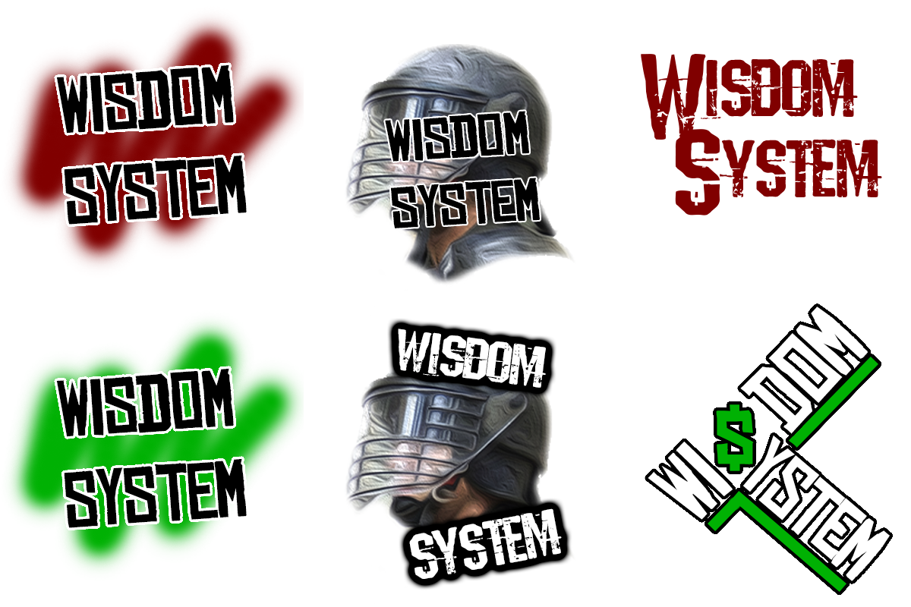
Stage 6: logo designs and reasonings

Slide 8
Design 1
Font: China Rocks Font
Colours: Colours 1, 3, and 4
Idea: This design was based on a grunge/ anti-establishment idea of graffiti and street art to represent not only the ideologies of the band, but also to create a sense of authenticity. The ‘spray-paint’ style in the background not only adds colour, making this logo stand out, but also creates a sense of rebellion which is one of the band’s main ideologies.

Slide 9
Design 2
Font: China Rocks Font
Colours: Colours 2, 3, and 4
Idea: This design idea is virtually the same as design 1, however early impressions of design 1 showed that the red ‘spray-paint’ design looked more like blood, which would give the wrong impression about the band and potentially show them as a ‘violent and dangerous’ group. This recolouring represents another typical street art colour.

Slide 10
Design 3
Font: China Rocks Font
Colours: Colours 3 and 4
Resources: Figure 1 (pixabay.com stock image)
Idea: This design is based upon the band’s pro-democratic stance with the inclusion of a riot police officer intended to make an audience question police states and power roles in society. The riot police officer has been blurred and modified in an artistic way in order to create the illusion of anonymity of power.

Slide 11
Design 4
Font: Eordeoghlakat Font
Colours: Colours 3 and 4
Resources: Figure 1(pixabay.com stock image)
Idea: This idea has the same basic principal as design 3, however the text has been altered. The font colour has been changed to white to make it stand out above the riot officer, with a new font being used to compliment this colour changed. In addition, the text has been moved so that the riot officer is more easily visible.

Slide 12
Design 5
Font: Eordeoghlakat Font
Colours: Colour 1
Idea: This design was created as a simplistic alternative to the other logo/ design-based options, instead opting for a simple, text-based approach. The linking of the letters W and S is also used in order to give the band a more simplified, abbreviated logo for use on promotional material/ social media etc. The colour choice was made to make the text sharp and for it to catch the attention of a potential audience

Slide 13
Design 6
Font: China Rocks Font
Colours: Colours 2, 3, and 4
Idea: This design is based heavily around the idea of a ‘capitalist establishment’ as shown by the use of green and the substitution of a dollar sign for the letter S. This creates a satirical approach as the band’s message is based around going against this establishment. In addition, the text is manipulated so that both words of the band name align and flow, and also to show that the system is (both literally through this design and metaphorically through the band’s music) is being tipped on its head.

Slide 14
Thank you for listening, I will now hear any feedback or questions you may have.

